Slide 1
EXCEL PROJECT
Stock Market
CRUD
VBA
Portfolio Tracker
Operations
Macros
& Return Analyzer
5
100%
Data Sheets
No DB Needed
A comprehensive Excel solution for tracking investments, analyzing returns, and cleaning raw stock data.
👤 Sarthak Mukherjee & Surojit Jana

Slide 2
Project Overview
A fully-featured Excel workbook for Indian stock market investors to track portfolios, calculate returns, and manage raw data — powered by VBA macros.
📊
Portfolio Tracking
📈
Return Analysis
Log every trade with broker, stock, sector, quantity and buy price in a structured table.
Calculate P&L, percentage returns and total portfolio value automatically.
🧹
Data Cleaning
🔍
Search & Filter
Remove duplicates, delete blank rows, and standardise data using VBA macros.
Filter stocks by broker, sector, portfolio type and date using Excel slicers.

Slide 3
Key Features
➕
👁
✏️
Add Stocks
View Portfolio
Edit Records
Enter new trades with all details — date, stock, sector, broker, price, quantity.
See your entire portfolio in a clean formatted table with colour-coded priorities.
Update existing entries for price changes, quantity adjustments, or corrections.
🗑
🔎
📉
Delete Entries
Search & Filter
P&L Calculation
Remove unwanted or outdated trades with a single click using VBA.
Find stocks by name, broker, sector or portfolio type instantly.
Auto-calculate profit/loss per stock and total portfolio return in percentage.

Slide 4
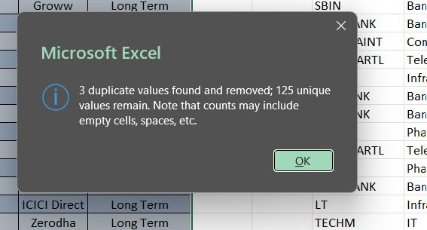
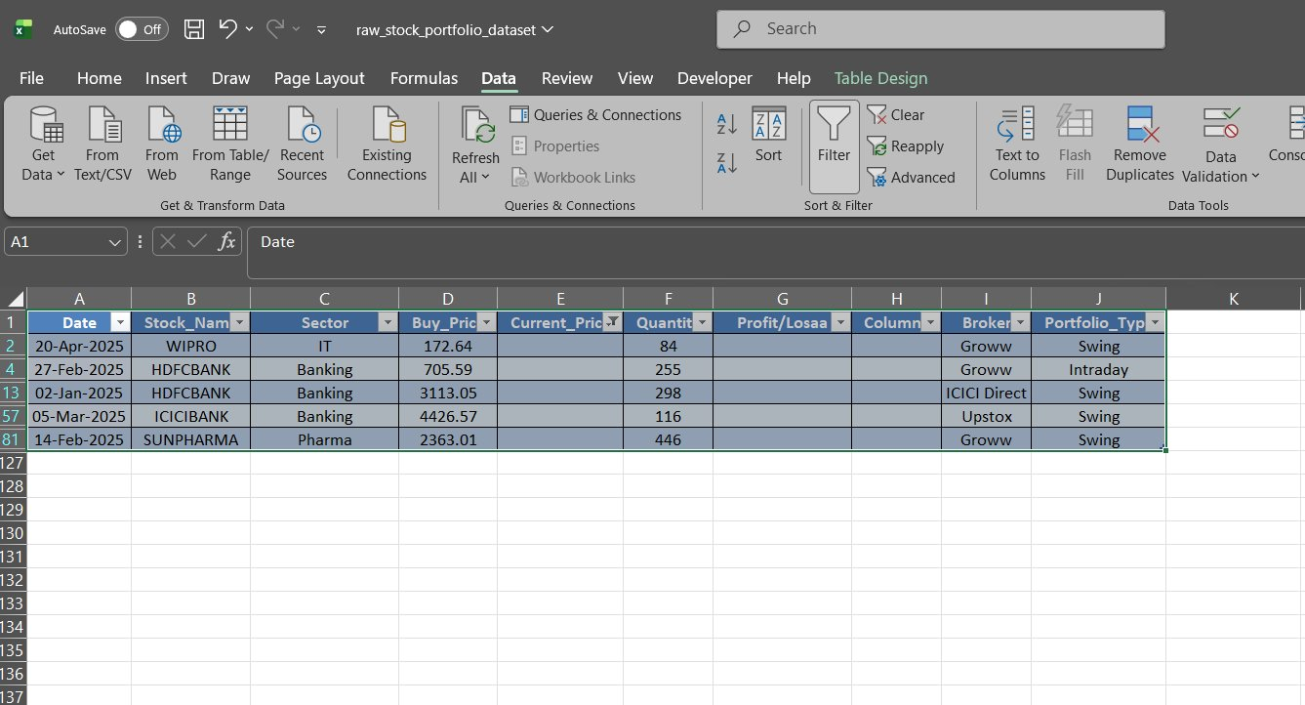
Data Cleaning — Screenshots
Remove Duplicates — Result Dialog
Raw Dataset — After Blank Row Deletion
3 duplicates found & removed · 125 unique values remain
Data tab → Remove Duplicates · Blank rows auto-deleted via VBA

Slide 5
Data Cleaning — Steps
01
Remove Duplicates
Used Excel's built-in Remove Duplicates tool under the Data tab. Detected 3 duplicate rows across 128 entries, leaving 125 unique records.
02
Delete Blank Rows
VBA macro scanned all rows from the bottom up and deleted any row where column A (Date) was empty, keeping data contiguous.
03
Standardise Columns
Fixed column header typo: 'Profit/Losaa' corrected to 'Profit/Loss'. Blank columns H removed. Data types verified for Date and numeric fields.
04
Validate Data Types
Buy_Price and Current_Price columns formatted as Number (2 decimal places). Date column formatted as DD-MMM-YYYY for consistency.

Slide 6
Project Structure — Excel Sheets
📄
raw_stock_portfolio_dataset
Main data table — all raw trade records (128 rows × 10 columns)
📄
Portfolio Summary
Aggregated view — total investment, current value, overall P&L
📄
Return Analyzer
Per-stock return % and profit/loss calculated from buy vs current price
📄
VBA Macros Sheet
Hosts all macro buttons: clean data, delete blanks, remove duplicates
📄
Charts Dashboard
Visual charts — sector allocation pie, broker split, P&L bar chart

Slide 7
CRUD Operations via VBA
CREATE
➕ /add (macro button)
Fill form → click Add → new row appended to dataset table automatically
READ
👁 / (portfolio view)
Home sheet displays all records with auto-formatting and colour coding
UPDATE
✏️ /edit (select row + edit)
Select any row → modify cell values → VBA validates and saves changes
DELETE
🗑 /delete (macro button)
Select row → click Delete button → row removed and IDs re-sequenced

Slide 8
Dataset Columns
Column Name
Description
Data Type
Color
Date
Trade entry date
DD-MMM-YYYY
Stock_Name
Company name / ticker
Text
Sector
Industry sector
Text
Buy_Price
Purchase price per share
Number (₹)
Current_Price
Today's market price
Number (₹)
Quantity
Number of shares held
Integer
Profit/Loss
Calculated gain/loss (₹)
Formula
Broker
Trading platform used
Text
Portfolio_Type
Trade style
Swing/Intraday/Long Term

Slide 9
Tools & Technologies
📊
⚙️
🧮
Microsoft Excel
VBA (Macros)
Excel Formulas
2016/365
Excel VBA
Advanced
Primary platform for data entry, tables, and charts
Automates data cleaning, CRUD operations and formatting
VLOOKUP, IF, SUMIF, conditional formatting used throughout
📉
🔢
🗃
Excel Charts
Power Query
Data Tables
Native
Get & Transform
Structured Ref
Bar, pie and line charts for portfolio visualisation
Used for connecting and refreshing external data sources
Excel tables (ListObjects) for structured data referencing

Slide 10
Project
Summary & Learnings
✅ Built a complete CRUD-enabled stock portfolio tracker in Excel
✅ Automated data cleaning with VBA: duplicates removed, blanks deleted
✅ Analysed 125 unique trade records across multiple brokers and sectors
✅ Created dynamic return analysis with profit/loss calculations per stock
✅ Designed a clean, professional dashboard using Excel charts & slicers
👤 Sarthak Mukherjee & Surojit Jana | Excel Project

